Slide 1

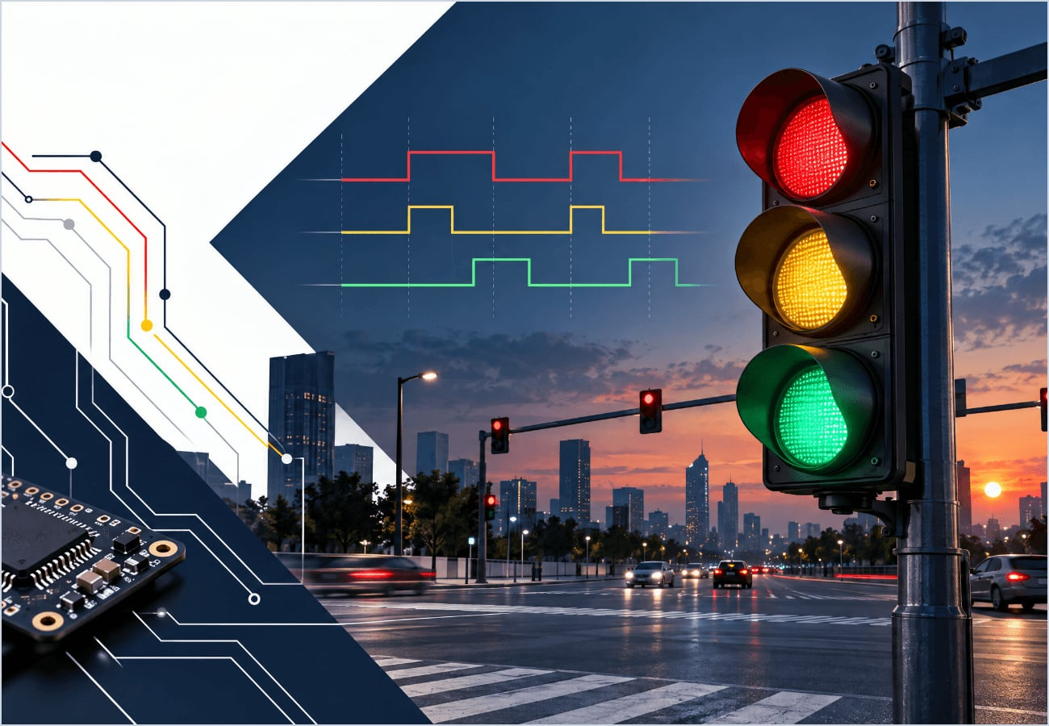
REAL-TIME
EMBEDDED SYSTEM
TRAFFIC SIGNAL CONTROL
PRESENTED BY
Hasmath nisha M(192524513)
DEPARTMENT
AI & Data Science
OPERATING SYSTEMS
SLIDE 01
Notes:
Welcome everyone. Today we will examine traffic signal control as a real-time embedded system. The goal is to connect operating-system concepts—tasks, timers, events, device drivers, and scheduling—to a familiar real-world application. I am presenting this topic as part of the Operating Systems course in the AI & Data Science department.

Slide 2

INTRODUCTION: TIMING IS THE PRODUCT
Embedded System
A specialized computing system designed to perform one or more dedicated functions, often with real-time computing constraints.
THE TRAFFIC SIGNAL CASE
Traffic signal control is a classic real-time application. Failure to switch signals within a fixed time window directly impacts safety and traffic flow.
Real-Time System
A system where the correctness of the result depends not only on the logical correctness but also on the time at which it is delivered.
Red → Stop (High Priority)
Yellow → Wait (Transition)
Green → Go (Flow)
OPERATING SYSTEMS
SLIDE 02
Notes:
Begin by distinguishing an embedded system from a general-purpose computer. An embedded system is built for a dedicated function, while a real-time system must produce the correct result within a required deadline. In traffic control, timing is part of correctness: a signal that changes too early or too late can create confusion and safety risks. Use the red, yellow, and green sequence to introduce the idea of states and transitions.

Slide 3


OPERATING SYSTEM: WHY AN RTOS?
REAL-TIME OS
QUICK RESPONSE
PREDICTABILITY
Predictability &
Deterministic Response
Known execution times even under heavy system load.
Minimal latency between a sensor trigger and the signal change.
PRIORITY HANDLING
Critical tasks (Emergency override) pre-empt standard signal cycles.
Unlike general-purpose OS (Windows/Linux), an RTOS guarantees a task will finish within a specific deadline.
ACCURATE TIMING
Precise clock management for duration control (e.g., exactly 60s for Red).
OPERATING SYSTEMS
SLIDE 03
Notes:
Explain that an RTOS is designed for deterministic behavior rather than maximum general-purpose throughput. It schedules tasks according to priority and timing requirements. For a traffic signal, the controller must respond quickly to timers and sensor events, maintain accurate phase durations, and continue operating predictably even when several tasks are active. Mention that emergency or safety-critical events can receive higher priority than normal background work.

Slide 4

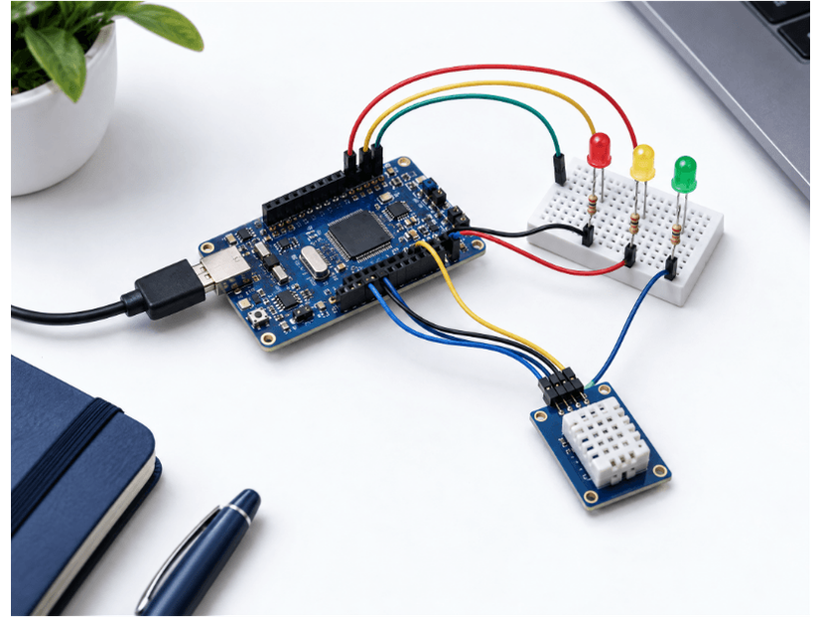
OS STRUCTURE: FROM CODE TO HARDWARE
TRAFFIC SIGNAL APPLICATION
(The logic for controlling the signals)
RTOS KERNEL (TASK & TIME MGMT)
(manages tasks, timers and priorities.)
DEVICE DRIVERS (LEDS, SENSORS)
(communicate with the traffic lights and sensors.)
Application: Logic for signal sequences.
MICROCONTROLLER (CPU/IO)
(Which actually controls the physical hardware )
Kernel: Manages priorities and multitasking.
Drivers: Bridge software logic to electrical signals.
Hardware: Physical execution environment.
TRAFFIC LIGHT HARDWARE
Notes:
Walk from the top layer down. The traffic-signal application contains the control logic. The RTOS kernel schedules tasks, manages timers, and coordinates events. Device drivers translate software commands into electrical signals for LEDs and sensors. The microcontroller executes the program and interfaces with the physical traffic lights. Emphasize that each layer has a clear responsibility, which makes the system easier to test and maintain.

Slide 5

TRAFFIC SIGNAL WORKING
RED
60s
Standard Cycle Implementation
GREEN
45s
SIGNAL STATE
ACTION
DURATION
All movements halted
60 sec
RED
Primary traffic flow
45 sec
GREEN
YELLOW
5s
Transition / Stop Prep
5 sec
YELLOW
RED (REPEAT)
OPERATING SYSTEMS
SLIDE 05
Notes:
Describe the controller as a repeating state machine. In this example, the red phase lasts 60 seconds, the green phase lasts 45 seconds, and the yellow phase lasts 5 seconds before returning to red. These values are illustrative operating parameters; a real deployment would use engineered timings and safety rules. The RTOS timer triggers each transition, while sensors can provide additional events such as pedestrian requests or traffic-density changes.

Slide 6

SYSTEM CALLS & EVENT HANDLING
// RTOS Transition Logic Example
void on_timer_event() {
// System Call: Change hardware state
write_gpio(GREEN_LED, LOW);
write_gpio(YELLOW_LED, HIGH);
// System Call: Set next timer
set_rtos_timer(5000); // 5 sec delay
}
// Triggered by Kernel Scheduler
Process Control
Manage signal tasks (Create, Suspend, Terminate).
Timer Functions
Handle signal durations and cyclic triggers.
Event Handling
Respond to asynchronous sensor inputs (Pedestrian button).
Device Control
Direct interface with GPIO pins for LED control.
SLIDE 06
Notes:
Use this slide to connect the application to operating-system services. Process-control functions start, suspend, or stop tasks. Timer functions schedule the next signal transition. Event handling receives sensor input, and device-control functions write to GPIO pins connected to LEDs or relays. The code example shows a timer event changing green to yellow, then setting a five-second timer for the next transition. The kernel scheduler invokes this logic at the required time.

Slide 7

ADVANTAGES IN THE REAL WORLD
RELIABILITY
EFFICIENCY
Deterministic task scheduling ensures the system never "hangs" or misses a critical transition.
Minimal resource consumption on microcontrollers, allowing long-term autonomous operation.
SAFETY
SCALABILITY
Accurate timing prevents overlaps in green signals across intersecting lanes.
RTOS architecture allows adding sensors (cameras, pressure plates) without rewriting core logic.
Notes:
Summarize the practical benefits. Deterministic scheduling improves reliability because deadlines are explicit. Efficient microcontroller operation supports continuous, low-power deployment. Accurate timing improves safety by preventing conflicting signal states. The layered RTOS design also supports scalability: additional sensors or emergency-vehicle features can be added without redesigning the entire system. These advantages explain why real-time embedded systems are common in transportation and industrial control.

Slide 8
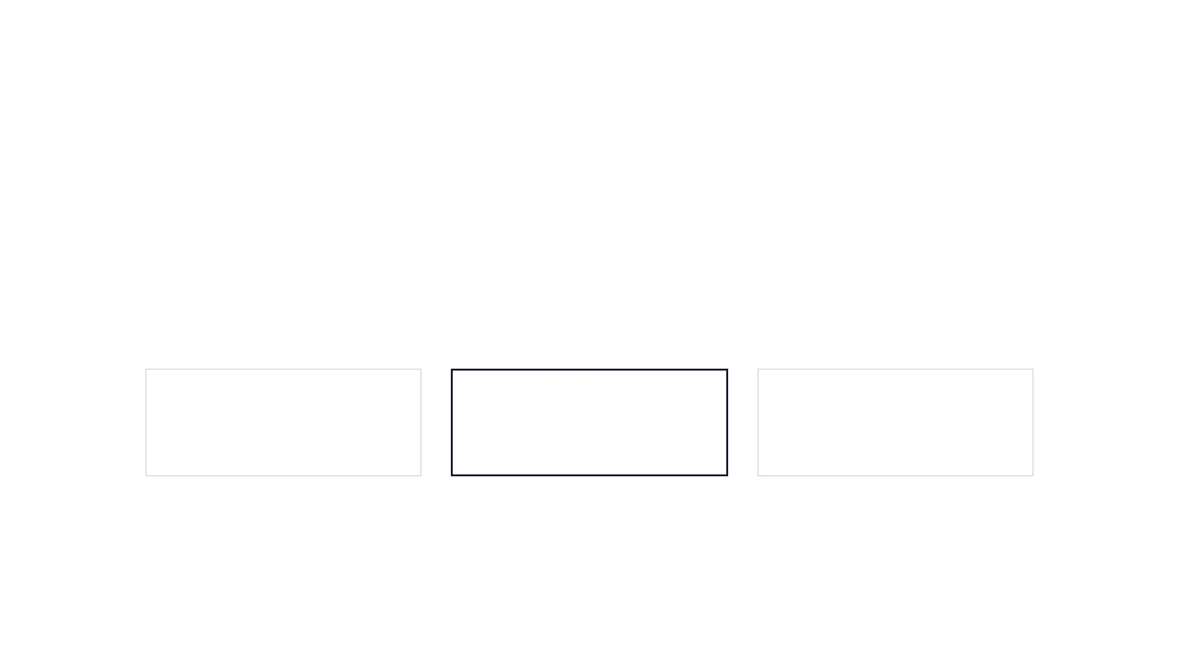
CONCLUSION: SMALL SYSTEM, STRICT TIMING
_______________________________________________________________________
A traffic signal controller is a powerful example of how hardware, software, and real-time operating systems converge to manage safety-critical environments.
HARDWARE
SOFTWARE
OUTCOME
Microcontrollers & LEDs
RTOS Kernel & Drivers
Safe & Reliable Traffic Flow
Notes:
Close with the main takeaway: traffic-signal control is simple to understand, but it demonstrates the essential principles of real-time embedded operating systems. Hardware provides the physical interface, the RTOS and drivers coordinate execution, and the application defines the signal policy. When these parts work together with accurate timing and fast event handling, the result is reliable and safer traffic flow. Invite questions about scheduling, timers, sensors, or RTOS design.

